Slide 1
Object Oriented Analysis and Design Using the UML

Slide 2
Introduction to Object Oriented Analysis and Design (OOAD)
Basic Concepts of Object Orientation
Basic Principles of Object Orientation
Strengths of Object Orientation
General UML Modeling Mechanisms

Slide 3
Basic Concepts of Object Orientation
Object
Class
Attribute
Operation
Interface (Polymorphism)
Component
Package
Subsystem
Relationships

Slide 4
Basic Concepts of Object Orientation
Object
Class
Attribute
Operation
Interface (Polymorphism)
Component
Package
Subsystem
Relationships

Slide 5
A More Formal Definition
An object is a concept, abstraction, or thing with sharp boundaries and meaning for an application
An object is something that has:
State
Behavior
Identity

Slide 6
What is a Class?
A class is a description of a group of objects with common properties (attributes), behavior (operations), relationships, and semantics
An object is an instance of a class
A class is an abstraction in that it:
Emphasizes relevant characteristics
Suppresses other characteristics
OO Principle: Abstraction
Notes:
A class has been called a “cookie cutter” for objects.

Slide 7
Class Compartments
A class is comprised of three sections
The first section contains the class name
The second section shows the structure (attributes)
The third section shows the behavior (operations)
Class Name
Professor
name
Attributes
empID
Operations
create( )
save( )
delete( )
change( )
Notes:
In Rose:
You may select which compartments are displayed via Diagram Object Properties for the diagram element.
You may select which items appear in which compartments using the Edit Compartment function for the diagram element.

Slide 8
The Relationship Between Classes and Objects
A class is an abstract definition of an object
It defines the structure and behavior of each object in the class
It serves as a template for creating objects
Objects are grouped into classes
Objects
Class
Professor
Professor Smith
Professor Mellon
Professor Jones
Notes:
This may seem repetitive with earlier slides, but it has been noted that the repetition of the discrimination between objects and classes is beneficial to “newbies”. If this does not apply to your class, you can cover this slide briefly.

Slide 9
What is an Attribute?
Object
Class
Attribute
Attribute Value
:CourseOffering
number = 101
startTime = 900
endTime = 1100
CourseOffering
number
startTime
endTime
:CourseOffering
number = 104
startTime = 1300
endTime = 1500

Slide 10
What is an Operation?
CourseOffering
Class
addStudent
deleteStudent
getStartTime
getEndTime
Operation

Slide 11
Basic Principles of Object Orientation
Object Orientation
Abstraction
Encapsulation
Modularity
Hierarchy

Slide 12
What is Abstraction?
Salesperson
Not saying Which salesperson – just a salesperson in general!!!
Product
Customer
Manages Complexity
Notes:
Discuss what makes a good abstraction with the students:
Concise,
Represents a single coherent concept,
etc.

Slide 13
What is Encapsulation?
Hide implementation from clients
Clients depend on interface
How does an object encapsulate?
What does it encapsulate?
Improves Resiliency
Notes:
Encapsulation is putting the “databits” and operations that manipulate them in the same place. Encapsulation DISALLOWS direct manipulation of things that have been encapsulated without utilising the supplied interface.
Another example - the accelerator on a car. You put your foot down and car goes faster - this works on most cars, and you don’t worry about the cables, electronics, engine, etc.

Slide 14
What is Modularity?
The breaking up of something complex into manageable pieces
Order
Entry
Order Processing System
Order
Fulfillment
Billing
Manages Complexity
Notes:
Modularity supports separation of concerns.
Another example of modularity is a car, which is made up of a body, chassis, engine, wheels, etc.

Slide 15
What is Hierarchy?
Asset
Increasing
abstraction
Levels of abstraction
BankAccount
Security
RealEstate
Savings
Checking
Stock
Bond
Decreasing
abstraction
Elements at the same level of the hierarchy should be at the same level of abstraction
Notes:
Hierarchy is not an organizational chart.
Hierarchy is not a functional decomposition.
Hierarchy is a taxonomic organization. The use of hierarchy makes it easy to recognize similarities and differences.
For example, in botany, plants are organized into families, chemistry uses a periodic table to organize the elements.
Another example -- telephone number, then a 0800 (free call) number, premium rate number, etc

Slide 16
What is Polymorphism?
The ability to hide many different implementations behind a single interface
Manufacturer B
Manufacturer A
Manufacturer C
OO Principle: Encapsulation
Notes:
Polymorphism will be addressed in more detail in the Class Design module.
Another example of polymorphism: There is a toddler sitting in front of some blocks and a teenager siting in front of a piano. An adult walks into the room and says “play”. The toddler plays with the blocks and the teenage plays the piano.
Another example - car accelerator on different cars.

Slide 17
What is an Interface?
Interfaces formalize polymorphism
Interfaces support “plug-and-play” architectures
Tube
<<interface>>
Shape
Pyramid
Draw
Move
Scale
Rotate
Cube
Realization relationship
(stay tuned for realization relationships)
Notes:
Interfaces are not abstract classes, as abstract classes allow you to provide default behavior for some/all of their methods. Interfaces provide no default behavior.

Slide 18
What is a Component?
A non-trivial, nearly independent, and replaceable part of a system that fulfills a clear function in the context of a well-defined architecture
A component may be
A source code component
A run time components or
An executable component
OO Principle: Encapsulation
Source File
Name
<<EXE>>
Executable
Name
<<DLL>>
Component
Name
Component Interface

Slide 19
What is a Package?
A package is a general purpose mechanism for organizing elements into groups
A model element which can contain other model elements
Uses
Organize the model under development
A unit of configuration management
OO Principle: Modularity
Package Name

Slide 20
What is a Subsystem?
A combination of a package (can contain other model elements) and a class (has behavior)
Realizes one or more interfaces which define its behavior
Realization
Subsystem
<<subsystem>>
Subsystem Name
Interface
Interface
OO Principles: Encapsulation and Modularity
(stay tuned for realization relationship)

Slide 21
Subsystems and Components
Components are the physical realization of an abstraction in the design
Subsystems can be used to represent the component in the design
Design Model
Implementation Model
<<subsystem>>
Component Name
Component
Name
Component Interface
Component Interface
OO Principles: Encapsulation and Modularity
Notes:
There are many different definitions and uses for subsystems. This is the definition we will focus on in this course.

Slide 22
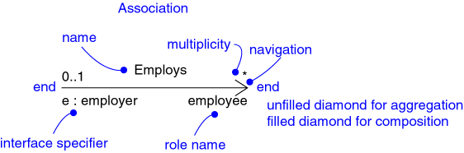
Relationships
Association
Aggregation
Composition
Dependency
Generalization
Realization
Notes:
Don’t cover the details of the graphic on this slide. The semantics of each of the relationships will be discussed later.

Slide 23
Relationships: Association
Models a semantic connection among classes
Association Name
Professor
Works for
University
Association
Role Names
Class
Professor
University
Employee
Employer
Notes:
Associations connect instances of two or more classes together for some duration (as opposed to a dependency relationship, which represents a temporary association between two instances).
Dependency relationships will be discussed in the Class Design module.
Do not use relationship/role names if they add no value/information to the model. Remember, readability and understandability of the model are key -- only add information that adds value, not clutter to the diagrams.

Slide 24
Relationships: Aggregation
A special form of association that models a whole-part relationship between an aggregate (the whole) and its parts
Whole
Part
Student
Schedule
Aggregation
Notes:
There are many examples of whole-part relationships: a Library contains Books, within a company Departments are made-up of Employees, a Computer is composed of a number of Devices. However, whether you model a relationship as an association or aggregation is really dependent on the domain being modeled. This is discussed in more detail on a later slide.

Slide 25
Relationships: Composition
A form of aggregation with strong ownership and coincident lifetimes
The parts cannot survive the whole/aggregate
Whole
Part
Student
Schedule
Aggregation
Notes:
Explain to the students that the diamond on this slide must be filled in with black so that the books would print right. If it was filled in with white, it would not be filled in in the books.
Note: Compositional aggregation can be shown in by nesting one class within another; however, Rose does not directly support the drawing of a class within a class.
Composition is not equivalent to containment by value, as some languages do not support containment by value (e.g., Java). By-value vs. by-reference is an implementation “thing”, whereas composition is a conceptual “thing” that can realized in the implementation using by-value, or by-reference (if the distinction is supported).
Note: In Rose, composition is modeled by specifying “by-value” for the containment property of a role of a relationship.

Slide 26
Association: Multiplicity and Navigation
Multiplicity defines how many objects participate in a relationships
The number of instances of one class related to ONE instance of the other class
Specified for each end of the association
Associations and aggregations are bi-directional by default, but it is often desirable to restrict navigation to one direction
If navigation is restricted, an arrowhead is added to indicate the direction of the navigation

Slide 27
Association: Multiplicity
1
Unspecified
Exactly one
Zero or more (many, unlimited)
One or more
Zero or one
Specified range
Multiple, disjoint ranges
0..*
*
1..*
0..1
2..4
2, 4..6
Notes:
Specification of multiplicity flushes out business rules and assumptions. The lower bound is critical, as the lower bound is what determines whether or not the relationship is optional (e.g., a lower bound of 0 indicates that the relationship is optional).
Multiplicity is needed on both ends of a relationship, even if you can only navigate in one direction. Even though there is no need to navigate in that direction, the multiplicity still provides valuable business information. Sometimes navigation decisions are made for performance reasons, which may change over time. The multiplicity should reflect the requirements.
Navigation is discussed on later slides.
The use of ‘N’ instead of ‘*’ is Booch, not UML (e.g., the use of “0..N” and ‘N’ is not UML).

Slide 28
Example: Multiplicity and Navigation
Multiplicity
Student
1
Schedule
0..*
Navigation

Slide 29
Relationships: Dependency
A relationship between two model elements where a change in one may cause a change in the other
Non-structural, “using” relationship
Class
Client
Supplier
Component
Package
Client
Supplier
Dependency relationship
ClientPackage
SupplierPackage
Dependency relationship

Slide 30
Relationships: Generalization
A relationship among classes where one class shares the structure and/or behavior of one or more classes
Defines a hierarchy of abstractions in which a subclass inherits from one or more superclasses
Single inheritance
Multiple inheritance
Generalization is an “is-a-kind of” relationship
Notes:
Generalization relationships are also permitted between packages. However, since packages do not themselves have any semantics, generalization between packages is not very common (generalization amongst subsystems, however, is practical).
According to Grady Booch: “The terms “inheritance” and “generalization” are, practically speaking, interchangeable. The UML standardized on calling the relationship “generalization” so as not to confuse people with language-specific meanings of inheritance. To confuse matters further, some call this an “is-a” or a “kind of” relationship (especially those into conceptual modeling in the cognitive sciences). So, for most users, it’s fair to use either term. For power users - people who care about things like the UML metamodel and specifying formal semantics of the same, the relationship is called “generalization” and applying such a relationship between, for example, two classes, results in the subclass inheriting the structure and operations of the superclass (i.e. inheritance is the mechanism).

Slide 31
Example: Single Inheritance
Ancestor
One class inherits from another
Account
balance
Superclass (parent)
name
number
Withdraw()
CreateStatement()
Generalization Relationship
Checking
Savings
Subclasses
Withdraw()
GetInterest()
Withdraw()
Descendents

Slide 32
Example: Multiple Inheritance
A class can inherit from several other classes
FlyingThing
Animal
multiple
inheritance
Airplane
Helicopter
Bird
Wolf
Horse
Use multiple inheritance only when needed, and
always with caution !

Slide 33
What Gets Inherited?
A subclass inherits its parent’s attributes, operations, and relationships
A subclass may:
Add additional attributes, operations, relationships
Redefine inherited operations (use caution!)
Common attributes, operations, and/or relationships are shown at the highest applicable level in the hierarchy
Inheritance leverages the similarities among classes
Notes:
Emphasize that when a change is made to a super class all descendent classes inherit the change.
Some languages do not support generalization. In these cases you will need to update the design model to reflect the characteristics of the implementation language. In cases where the implementation language does not support generalization between classes you must “design generalization in”. See the language specific appendices for more information. See Class Design for more information.

Slide 34
Example: What Gets Inherited
GroundVehicle
Person
Superclass (parent)
weight
owner
licenseNumber
0..*
1
register( )
generalization
Car
Truck
Trailer
Subclass
size
tonnage
getTax( )
Notes:
Ask the class the following to test their understanding:
“Without looking at your notes:
How many operations does Car have? Answer: 1
How may relationships? Answer: 1
How many operations does Truck have? Answer: 2
How may relationships? Answer: 2”
Generalization provides a way to implement polymorphism in cases where polymorphism is implemented the same way for a set of classes. The use of generalization to support polymorphism is discussed in more detail in the Class Design module

Slide 35
Relationships: Realization
One classifier serves as the contract that the other classifier agrees to carry out
Found between:
Interfaces and the classifiers that realize them
Use cases and the collaborations that realize them
Class
Component
Subsystem
Interface
Interface
Interface
Elided form
Canonical form
Use Case
Use-Case Realization
Notes:
We discussed subsystems earlier in this module. We will look at interfaces and the realization relationship in more detail in the Architectural Design module.

Slide 36
Strengths of Object Orientation
A single paradigm
Facilitates architectural and code reuse
Models more closely reflect the real world
More accurately describe corporate data and processes
Decomposed based on natural partitioning
Easier to understand and maintain
Stability
A small change in requirements does not mean massive changes in the system under development
Notes:
Review the 4 basic principles of OO (abstraction, encapsulation, modularity, and hierarchy) and why they are good. Ask the students to name the OO concepts (e.g., class, package, interface, etc.) that support those principles.
Emphasize that OO facilitates the following best practices:
Develop Iteratively
Model Visually
Use Component Architecture

Slide 37
Class Diagram for the Sales Example
Sale
seller
buyer
item sold
shipping mechanism
Salesperson
Customer
Product
Vehicle
Corporate
Individual
Truck
Train
Notes:
Use this slide to review the key concepts and UML notation described earlier in this module. For example, ask the students the following:
What are the classes in this diagram?
What relationship exists between Salesperson and Sale?
What relationship exists between Corporate and Customer?
How would you interpret the diagram?

Slide 38
Stereotypes
Classify and extend the UML notational elements
Define a new model element in terms of another model element
May be applied to all modeling elements
Represented with name in guillemets or as a different icon
<<boundary>>
MyBoundaryClass
MyBoundaryClass

Slide 39
Example: Stereotypes
<<boundary>>
<<boundary>>
Sample boundary class (stereotype)
Stereotype of ‘dependency relation’
Stereotype of <<Processor>>
These create new symbols using
accustomed graphics.
<<trace>>
DesignClass
<<Processor>>
Processor #1
Processor #1
Notes:
The <<trace>> dependency represents tracing an analysis class to the design class it became.
The use of boundary classes will be discussed in the Use-Case Analysis module and the use of processors will be discussed in the Describe Distribution module.

Slide 40
Notes
A note can be added to any UML element
Notes may be added to add more information to the diagram
It is a ‘dog eared’ rectangle
The note may be anchored to an element with a dashed line
There can be up to one
MaintainScheduleForm per
MaintainScheduleForm
user session.

Slide 41
Tagged Values
Extensions of the properties, or specific attributes, of a UML element
Some properties are defined by UML
Persistence
Location (e.g., client, server)
Properties can be created by UML modelers for any purpose
PersistentClass {persistence}
anObject : ClassA {location=server}

Slide 42
Constraints
Supports the addition of new rules or modification of existing rules
Member
1
Professor
Department
1..*
{subset}
Department Head
1
1
This notation is used to capture two relationships between Professor-type objects
and Department-type objects; where one relationship is a subset of another….
Shows how UML can be tailored to correctly modeling exact relationships….
Notes:
In Rose, constraints between relationships are drawn using the dependency relationship and just typing in the constraint, including enclosing brackets.

Slide 43
OOPs Design Principle

Slide 44
Object Oriented Design Principle
Cohesion
Coupling
Open Close Principle
Dependency Inversion Principle
Interface Segregation Principle
Single Responsibility Principle
Liskov's Substitution Principle

Slide 45
Cohesion and Coupling
Cohesion and Coupling deal with the quality of an OO design. Generally, good OO design should be loosely coupled and highly cohesive.
Coupling: Coupling is the degree to which one class knows about another class.
Cohesion: Cohesion is used to indicate the degree to which a class has a single, well-focused purpose.

Slide 46
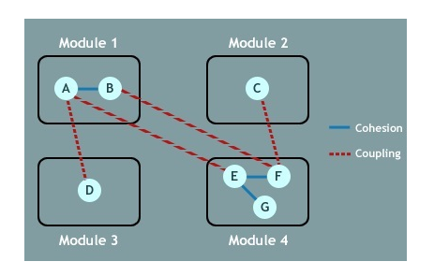

Slide 47
Cohesion Vs Coupling
Cohesion is the indication of the relationship within module.
Cohesion shows the module’s relative functional strength.
Coupling is the indication of the relationships between modules.
Coupling shows the relative independence among the modules.

Slide 48
Continue…
Cohesion is a degree (quality) to which a component / module focuses on the single thing.
Cohesion is the kind of natural extension of data hiding for example, class having all members visible with a package having default visibility.
Coupling is a degree to which a component / module is connected to the other modules.
Making private fields, private methods and non public classes provides loose coupling.

Slide 49
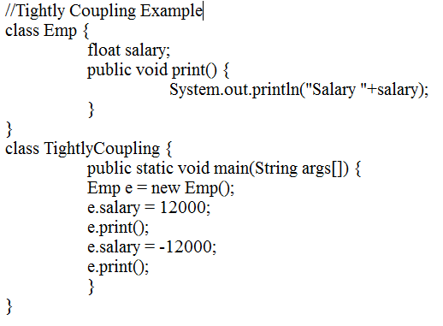

Slide 50
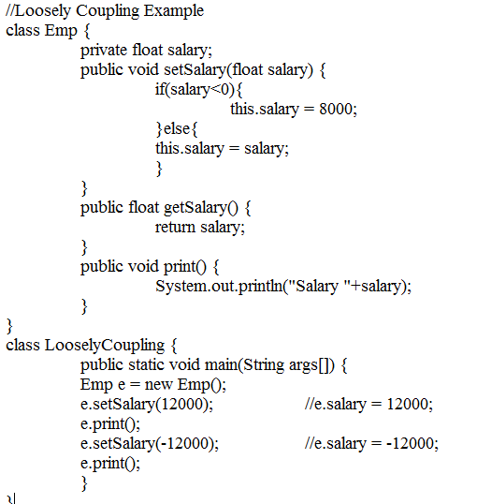

Slide 51
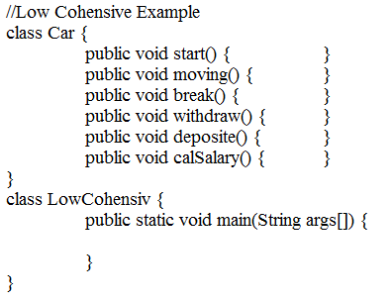

Slide 52
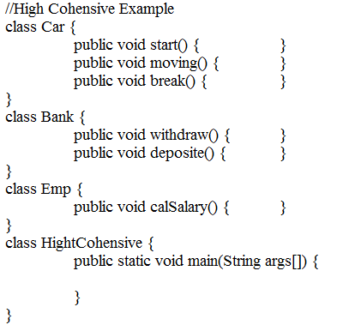

Slide 53
Conclusion
Coupling refers to the degree in which one class knows about another, or makes use of another classes’ members
Loose coupling is GOOD as classes are well encapsulated to minimise references to each other
Tight coupling is BAD because a class shouldn’t know about the workings of another
Cohesion refers to the degree in which a class has a single, well defined purpose
High cohesion is GOOD as a class does only what it should
Low cohesion is BAD because a class is trying to solve everything and not just its specific purposes

Slide 54
Solid Principles
S.O.L.I.D is an acronym for the first five object-oriented design(OOD) principles by Robert C. Martin, popularly known as Uncle Bob.
S.O.L.I.D STANDS FOR:
S – Single- Responsibility principle
O – Open-closed principle
L – Liskov substitution principle
I – Interface segregation principle
D – Dependency Inversion Principle

Slide 55
Single Responsibility Principle
S.R.P for short – this principle states that:
“A class should have one and only one reason to change, meaning that a class should have only one job.”
When we design our classes, we should take care that one class at the most is responsible for doing one task or functionality among the whole set of responsibilities that it has.
Also note that the classes defined using the Single Responsibility Principle are inherently cohesive in nature

Slide 56
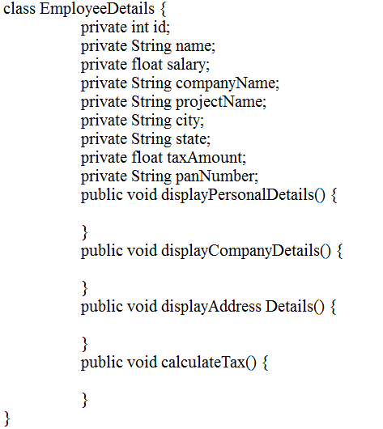

Slide 57
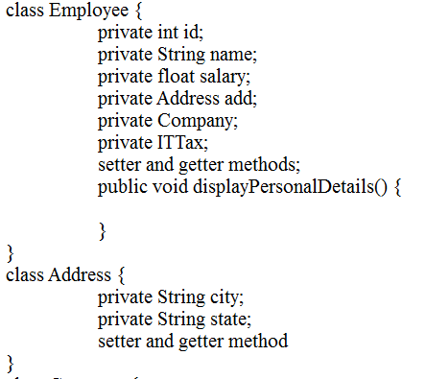
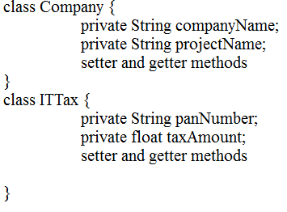

Slide 58
Open – closed Principle
“Object or entities should be open for extension, but closed for modification”
This simply means that a class should be easily extendable without modifying the class itself.
Open -> If attributes or behaviour can be added to a class it can be said to be “open”.
Close -> If a class is re-usable or specifically available for extending as a base class then it is closed.

Slide 59
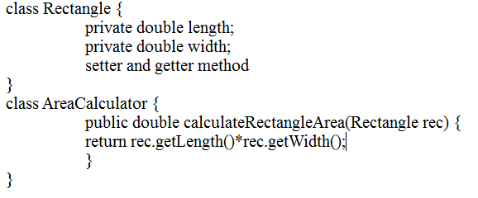

Slide 60
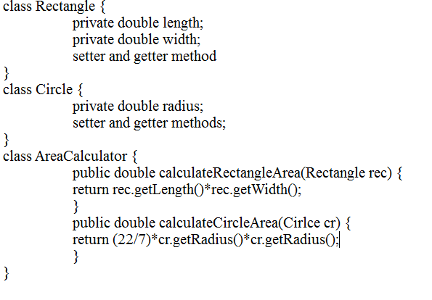

Slide 61
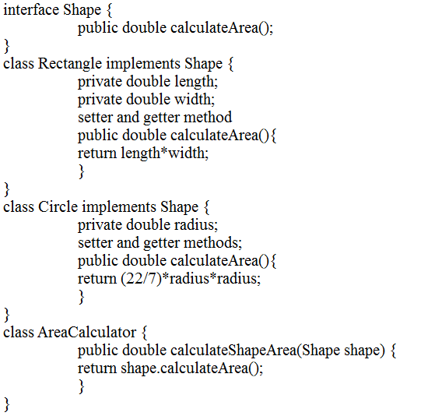

Slide 62
Liskov Substitution Principle
“objects in a program should be replaceable with instances of their subtypes without altering the correctness of that program”
This is actually in line with what Java also allows. A superclass reference can hold a subclass object i.e. superclass can be replaced by subclass in a superclass reference at any time. So, Java inheritance mechanism follows Liskov Substitution Principle.

Slide 63
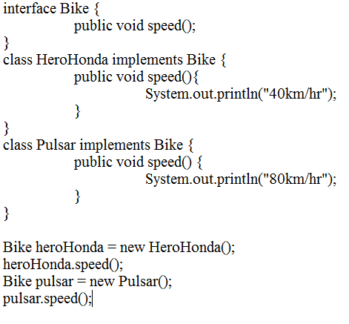

Slide 64
Interface Segregation Principle
“Many client specific interfaces are better than one general purpose interface”
Instead of having a single interface catering to all the clients, i.e. holding all the methods for all the clients, it is better to have multiple interfaces with each interface containing methods for a client-specific functionality or to have functionally cohesive interfaces.

Slide 65
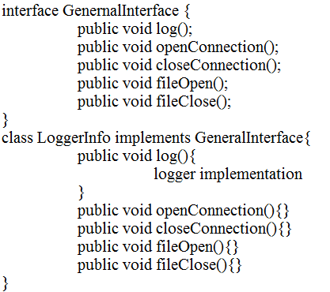
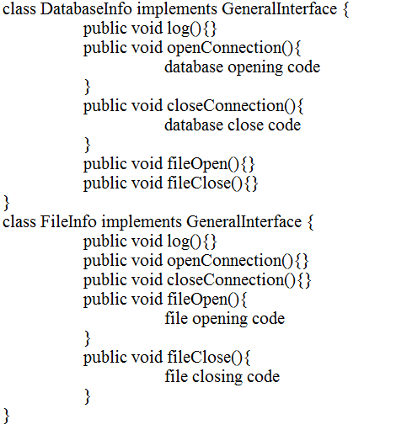

Slide 66
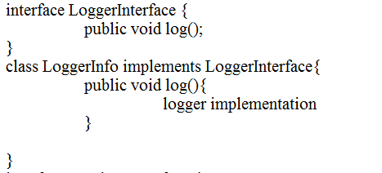
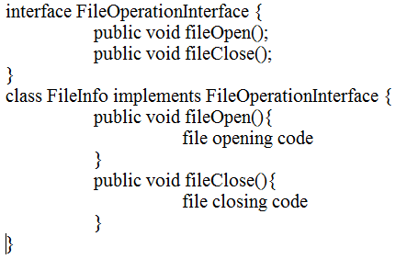
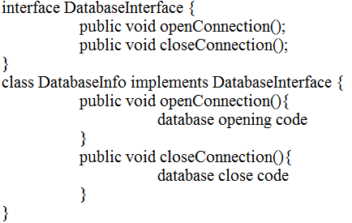

Slide 67
Dependency Inversion principle
“Abstractions should not depend upon details. Details should depend upon abstractions”
Or
“High-level modules should not depend on low-level modules. Both should depend on abstractions.”

Slide 68
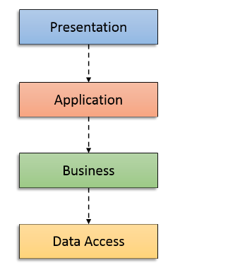

Slide 69
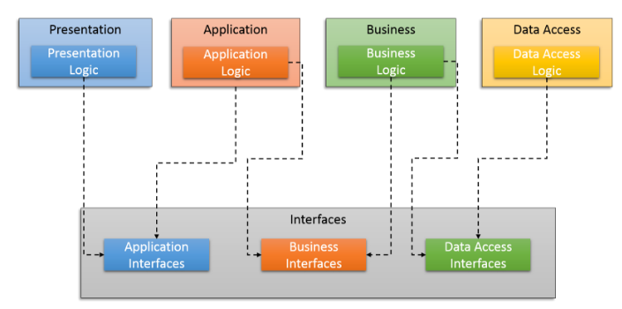

Slide 70
Design Pattern

Slide 71
What is Design Pattern
A design pattern is a general reusable solution to a commonly occurring problem in software design.
It is a template for how to solve a problem that can be used in many different situations.
Patterns are formalized best practices that the programmer can use to solve common problems when designing an application or system.

Slide 72
Gang of Four Design Patterns
These are design patterns which were defined by four authors
Erich Gamma
Richard Helm
Ralph Johnson and
John Vlissides in their book Design Patterns:

Slide 73
Benefits & Drawbacks
Benefits:
Design patterns enable large-scale reuse of software architectures
Patterns explicitly capture expert knowledge and design tradeoffs, and make this expertise more widely available
Patterns help improve developer communication
Drawbacks:
Patterns do not lead to direct code reuse
Patterns are deceptively simple
Teams may suffer from pattern overload
Patterns are validated by experience and discussion rather than by automated testing

Slide 74
Kinds of Patterns
Analysis Patterns
for modeling requirements
Architectural Patterns
for major components of a software system
Design Patterns
for software components
Programming Patterns
for specific languages
Notes:
Example of Architectural Patterns is MVC.
Programming Patterns are also known as Idioms. Examples are Accessor Methods and Immutable Objects.
The focus of this presentation is on Design Patterns.

Slide 75
Design Pattern Classification
CREATIONAL PATTERNS
Deals with Initializing and Configuring Classes and Objects.
STRUCTURAL PATTERNS
Deals with Decoupling interface and Implementation of classes and objects.
BEHAVIORAL PATTERNS
Deals with Dynamic interactions among classes and objects.
Notes:
Creational Patterns deal with initializing and configuring classes and objects.
Structural Patterns deal with decoupling interface and implementation of classes and objects.
Behavioral Patterns deal with dynamic interactions among classes and objects.
There are other design patterns in existence but these are the most common

Slide 76
CREATIONAL PATTERNS
Factory Method
Abstract Factory
Builder
Prototype
Singleton

Slide 77
STRUCTURAL PATTERNS
Adapter
Bridge
Composite
Decorator
Façade
Flyweight
Proxy

Slide 78
BEHAVIORAL PATTERNS
Chain of Responsibility
Command
Interpreter
Iterator
Mediator
Memento
Observer
State
Strategy
Template Method
Visitor

Slide 79
Creational Patterns

Slide 80
Factory Method
Definition
A Factory Pattern or Factory Method Pattern says that just define an interface or abstract class for creating an object but let the subclasses decide which class to instantiate. In other words, subclasses are responsible to create the instance of the class
Problem & Context
If an object needs to know the selection criteria to instantiate an appropriate class, this results in a high degree of coupling. Whenever the selection criteria change, every object that uses the class must be changed correspondingly
Solution
Encapsulate the functionality required to select and instantiate the appropriate class. One way to do this is to create an abstract class or an interface that declares the factory method. Different subclasses can then implement the method in its entirety
Notes:
Frequency of use: Medium high (4 of 5)
Sample Application:
Creating different documents (e.g., Report, Resume, etc…) from a base Document class.

Slide 81
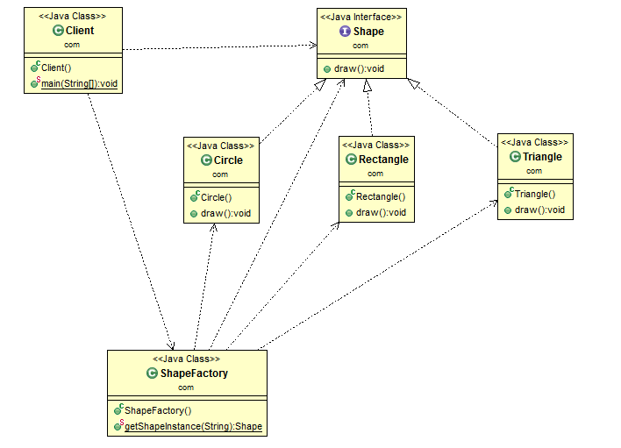

Slide 82
Pros and cons factory pattern
Pros
Abstraction, Polymorphism, Loosely coupling
Shields clients from concrete classes
if a framework uses the Factory Method pattern, it enables third-party developers to plug-in new Shape.
Cons
Too much abstracts.
Inheritance based
one for the concrete Shape and one for the concrete Color

Slide 83
Abstract Factory
Definition
Provides an interface for creating families of related or dependent objects without specifying their concrete sub classes
Problem & Context
Useful when an object wants to create an instance of a suite of related and dependent classes without having to know which specific concrete class is instantiated. In its absence, the required implementation needs to be present wherever such an instance is created
Solution
Provide the necessary interface for creating instances. Different concrete factories implement this interface. In Java, it is an abstract class with its concrete subclasses as factories. Each factory is responsible for creating and providing access to the objects
Notes:
Frequency of use: Medium high (4 of 5)
Sample Application:
Creation of different animal worlds from different Continents for a computer game using different factories. Although the animals created by the Continent factories are different, the interactions among the animals remain the same.

Slide 84
Use of Abstract factory pattern
Abstract factory makes sense when you need to create different products of same family without actually knowing the family.
Abstract Factory pattern is a pattern to create Factory of Factory

Slide 85
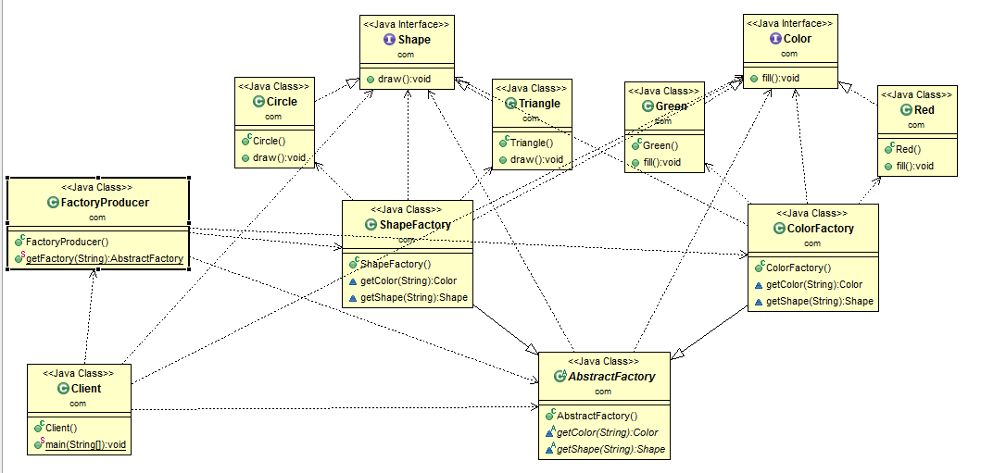

Slide 86
Pros and cons of abstract factory
Pros
Shields clients from concrete classes.
Easy to switch product family at runtime
Just change concrete factory
Keep it in the family
Cons
Adding a new product means changing factory interface + all concrete factories

Slide 87
Factory method and Abstract factory
Factory Method uses inheritance - the base class declares the abstract creation method and uses it internally, subclasses provide the definition for the creation method.
An Abstract Factory is used by composition - the base class often is a purely abstract class (or interface), and instances of concrete implementations are passed to its clients, which aren't related to the factories by inheritance.

Slide 88
Real time example
I would say "Abstarct factory is another layer of abstraction over factory". "It gives you Factory to create Objects".
In JAX-P
DocumentBuilderFactory dbf = DocumentBuilderFactory.newInstance();
DocumentBuilder db = dbf.newDocumentBuilder();
Document doc = db.parse(new File(“emp.xml”));

Slide 89
Builder
Definition
Separates the construction of a complex object from its representation so that the same construction process can create different representations
Problem & Context
Object construction details are kept within the object as part of its constructor. This may not be effective when the object being created is complex and the object creation process produces different representations of the object. The object can become bulky (construction bloat) and less modular
Solution
Move the construction logic out of the object class to separate classes referred to as builder classes. A dedicated object referred to as a Director, is responsible for invoking different builder methods required for the construction of the final object. Different client objects can make use of the Director object to create the required object
Notes:
Frequency of use: medium (3 of 5)
Sample Application:
1. Different vehicles are assembled in a step-by-step fashion. The Shop uses VehicleBuilders to construct a variety of Vehicles in a series of sequential steps.
2. A Web hosting company offers three different types of hosting packages — Basic, Premium and Premium Plus — on Windows & Unix platforms. Then, query the features of different types of hosting packages offered by the Web hosting company.

Slide 90
Builder pattern use
Dealing with constructors that require too many parameters.
It provides clear separation between the construction and representation of an object.
It provides better control over construction process.
It supports to change the internal representation of objects.

Slide 91
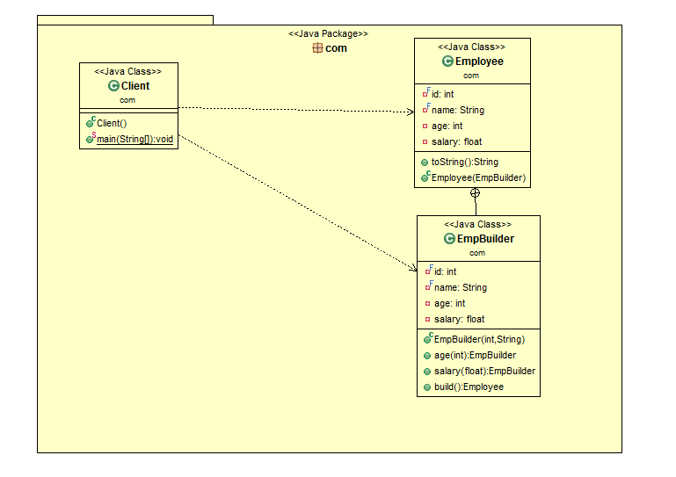

Slide 92
Pts
The Employee constructor is private, which means that this class can not be directly instantiated from the client code.
The class is once again immutable. All attributes are final and they’re set on the constructor. Additionally, we only provide getters for them.
The builder uses the Fluent Interface idiom to make the client code more readable.
The builder constructor only receives the required attributes and this attributes are the only ones that are defined “final” on the builder to ensure that their values are set on the constructor.

Slide 93
Real use of this pattern is
StringBuilder is pre-defined class internally implements Builder pattern.
Example
SringBuilder sb = new StringBuilder();
String msg = sb.append("Hi").append("Hello, ").append("How r you").delete(0,1).toString();
System.out.println(msg);

Slide 94
Real time example in API
@GET
public Response passIdResponse(@PathParam("id") int id) {
System.out.println("The employee id is "+id);
String output="The employee id is "+id;
return Response.status(200).entity(output).build();
Or
return Response.status(200).build();
Or
return Response.status(200).cookie(CookiesRef).entity(output).build();
}

Slide 95
Pros and cons of builder pattern
Pros
The client code is easier to write and, more importantly, to read.
The fact that the builder class is usually a static member class of the class it builds, they can evolve together fairly easy.
Cons
The fact that you have to duplicate the class’ attributes on the builder.

Slide 96
Abstract factory Vs Builder
Emphasizes a family of product objects (either simple or complex).
Focus on *what* is made.
*Every* method call creates and returns different objects
Focuses on constructing a complex object step by step.
Focus on *how* it is made.
Only the *last* method call returns the object, while other calls partially build the object

Slide 97
Prototype
Definition
Specify the kinds of objects to create using a prototypical instance, and create new objects by copying this prototype
Problem & Context
When clients need to create a set of objects that are cost prohibitive and alike or differ only in terms of their state, create one object upfront and designate it as a prototype object or simply make a copy of the prototype object
Solution
Provide a way for clients to create a copy of the prototype object. By default, all Java objects inherit the built in clone() method that creates a clone of the original object
Notes:
Frequency of use: medium low (2 of 5)
Sample Application:
New Color objects are created by copying pre-existing, user-defined Colors of the same type.
Every new Supervisor type account is given exactly the same set of permissions as the prototypical Supervisor UserAccount object. Consider a new user account group to represent marketing coordinators, with additional permission to access the color printer.

Slide 98
Pts
Prototype pattern may look similar to builder design pattern. There is a huge difference to it. If you remember, “the same construction process can create different representations” is the key in builder pattern. But not in the case of prototype pattern.
You just have to copy the existing instance in hand.

Slide 99
Copy object
Types of copy
Shallow copy: Generally clone method of an object, creates a new instance of the same class and copies all the fields to the new instance and returns it. This is nothing but shallow copy.
Deep copy : When the copied object contains some other object its references are copied recursively in deep copy. When you implement deep copy be careful as you might fall for cyclic dependencies. If you don’t want to implement deep copy yourselves then you can go for serialization.

Slide 100
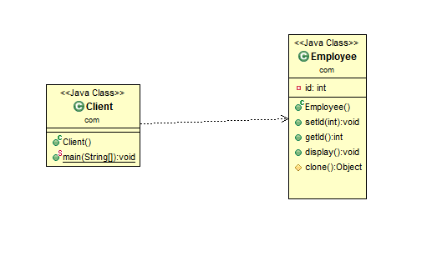

Slide 101
Pros and cons prototype pattern
Pros
Don’t need to call a constructor explicitly or when a system don’t need to depend on way of objects creation.
Hides the complexities of making new instances from the client.
Cons
Classes that have circular references can be difficult to deep clone.

Slide 102
Singleton
Definition
Ensures a class has only one instance and provide a global point of access to it
Problem & Context
Sometimes there may be a need to have one and only one instance of a given class during the lifetime of an application. This may be due to necessity or, more often, because only a single instance of the class is sufficient
Solution
Create a class with a method that creates a new instance of the object if one does not exist. If one does exist, it returns a reference to the object that already exists. To make sure that the object cannot be instantiated any other way, the constructor is made either private or protected
Notes:
Frequency of use: High (5 of 5)
Sample Application:
Consider a LoadBalancing object. Only a single instance (the singleton) of the class can be created because servers may dynamically come on- or off-line and every request must go through the one object that has knowledge about the state of the (web) farm.
A single database connection object in an application

Slide 103
Singleton pattern use
You use a singleton when you need to manage a shared resource.
When you load a configuration Properties object, either from the database or a file.

Slide 104
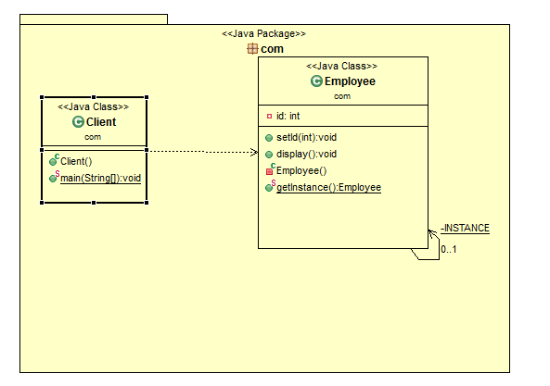

Slide 105
Pros and cons of singleton pattern
Pros
Better memory usage
Needs initialisation once
Cons
They are generally used as a global instance, why is that so bad? Because you hide the dependencies of your application in your code, instead of exposing them through the interfaces.
They violate the single responsibility principle: by virtue of the fact that they control their own creation and lifecycle.

Slide 106
Structural Patterns

Slide 107
Adapter
Definition
Converts the interface of a class into another interface clients expect. Adapter lets classes work together that couldn't otherwise because of incompatible interfaces
Problem & Context
Sometimes an existing class may provide the functionality required by a client, but its interface may not be what the client expects. In such cases, the existing interface needs to be converted into an interface that the client expects, preserving the reusability of the existing class
Solution
Define a wrapper class around the object with the incompatible interface. The adapter provides the required interface expected by the client. The implementation of the adapter interface converts client requests into calls to the adoptee class interface
Notes:
The interface used here refers to the programming interface that a class exposes. The programming interface is its set of methods.
Frequency of use: Medium high (4 of 5)
Sample Application
The use of a legacy chemical databank where Chemical compound objects access the databank through an Adapter interface.
Validate a given customer address using a larger customer data management application. The existing address validator is for the US but consider using it for residents of Canada.

Slide 108
Use of Adapter pattern
It allows two or more previously incompatible objects to interact.
It allows reusability of existing functionality.
When an object needs to utilize an existing class with an incompatible interface.
When you want to create a reusable class that cooperates with classes which don't have compatible interfaces.

Slide 109
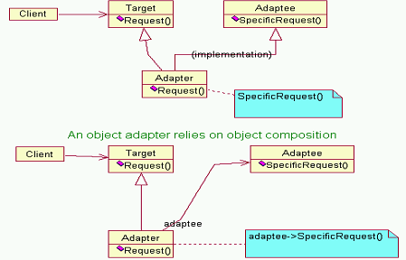

Slide 110
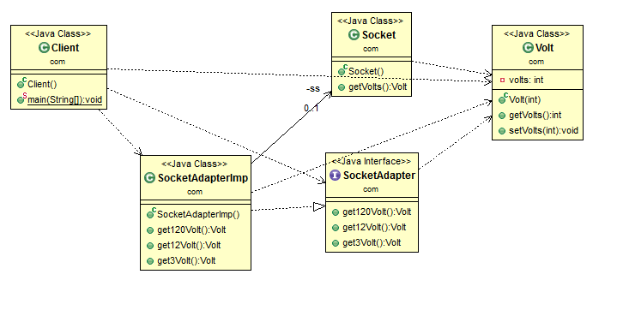

Slide 111
Real time API example of Adapter
WindowAdapter :
KeyAdapter :
MouseAdapter :
InputStreamReader and BufferedReader

Slide 112
Pros and cons of adapter pattern
Pros
It allows more flexibility in design.
They handle logic by wrapping a new interface around that of an existing class so you can use new APIs (with different interfaces) and avoid breaking existing implementations.
Cons
It unnecessarily increases the size of the code as class inheritance is less used and lot of code is needlessly duplicated between classes.
Sometimes many adaptations are required along an adapter chain to reach the type which is required.

Slide 113
Bridge
Definition
Decouples an abstraction from its implementation so that the two can vary independently
Problem & Context
An abstraction can be designed as an interface with one or more concrete implementers. When sub classing the hierarchy, it could lead to an exponential number of subclasses. And since both the interface and its implementation are closely tied together, they cannot be independently varied without affecting each other
Solution
Put both the interfaces and the implementations into separate class hierarchies. The Abstraction maintains an object reference of the Implementer type. A client application can choose a desired abstraction type from the Abstraction class hierarchy. The abstraction object can then be configured with an instance of an appropriate implementer from the Implementer class hierarchy
Notes:
Frequency of use: Medium (3 of 5)
Sample Application:
An application that reads and writes different types of data (plain text, binary, etc.) to and from different destinations such as a file, a URL or a database
An application with a database backend uses ODBC/JDBC drivers from different vendors

Slide 115
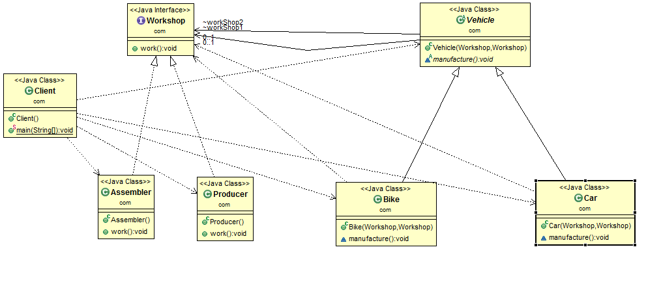

Slide 116
Real time example of Bridge
JDBC API ie Connection, Statetement, ResultSet etc
RMI API
SOA Architecture

Slide 117
Composite
Definition
Composes objects into tree structures to represent part-whole hierarchies. Composites let clients treat individual objects and compositions of objects uniformly
Problem & Context
Useful in designing a common interface for both individual and composite components so that client programs can view both the individual components and groups of components uniformly
Solution
Simulate a file system that consists of directories, files and an interface called FileSystem with methods (such as getSize(), getComponent(), addComponent()) common for both File and Directory components. File and Directory classes are the implementers of the interface. A typical client would create a set of FileSystem objects including a hierarchy of file system objects. The client can treat both the Directory and File objects identically
Notes:
Frequency of use: High (5 of 5)
Sample application:
Consider a product database consisting of categories and items. A category can contain items and also other categories.

Slide 118
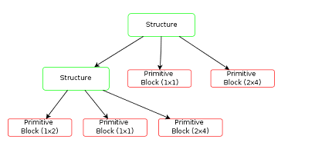
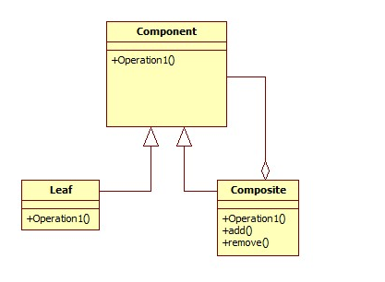

Slide 119
Use of composite pattern
Composite Pattern lets clients to treat individual Objects as well compositions (of Individual Objects) uniformly. For instance on double click of folder it should be open the folder. On double of file it should be opened in corresponding Program. Operation is same but behaves based on whether it is Individual Objects or Compositions

Slide 120
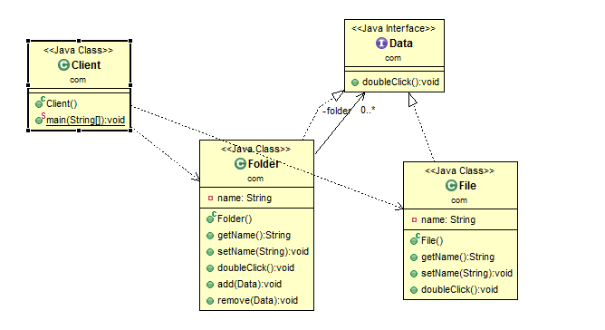

Slide 121
Pros and cons of composite pattern
Pros
It makes it easy to add new kids of components
It makes client simpler
Cons
It makes it harder to restrict the type of component of a composite.

Slide 122
Real use of composite pattern
Reading XML data from a XML file ie read a tag check it, it is complex or simple. If it is a complex then read its child tag other wise read its data. Continue this process till get the simple tags.

Slide 123
Decorator
Definition
Attaches additional responsibilities to an object dynamically. Decorators provide a flexible alternative to sub classing for extending functionality
Problem & Context
This pattern allows new/additional behavior to be added to an existing method of an object dynamically. Since classes cannot be created at runtime and it is typically not possible to predict what extensions will be needed at design time, a new class would have to be made for every possible combination. By contrast, decorators are objects, created at runtime, and can be combined on a per-use basis
Solution
Pass the original object as a parameter to the constructor of the decorator, with the decorator implementing the new functionality. The interface of the original object needs to be maintained by the decorator
Notes:
Frequency of use: Medium high (4 of 5)
Sample application:
A File Reader utility class with a method to read lines from a file
The scrollbar in web browsers will display only if necessary and hides itself otherwise. The scrollbar is the decorator to the web page.

Slide 125
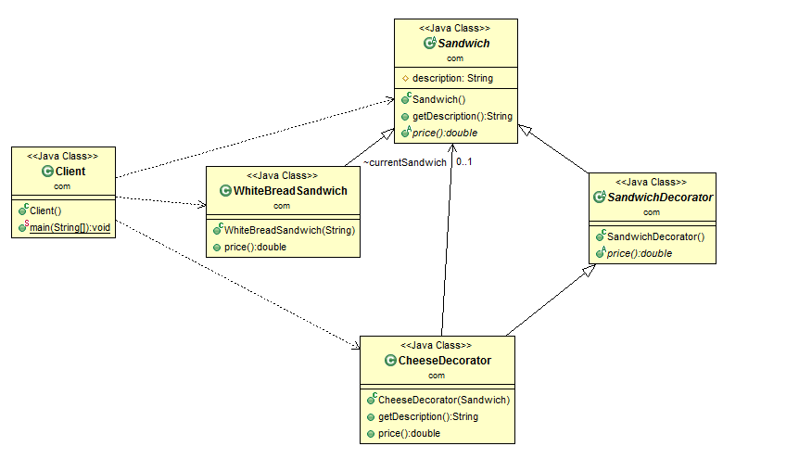

Slide 126
Pts
The decorator must be of the same type of object, which they are decorating. This can be achieved either by implementing the interface of the object or by extending an abstract class of the original class.
Decorator is based on Composition, which means it needs an original object to decorate it. This is achieved by creating a constructor on decorator class which accepts a base type of original object.
Decorator pattern is also a good example of Open Closed design principle

Slide 127
Continue…
Decorator class adds new functionality before or after delegating the task to the original object. In this example, the price of Decorator i.e. cheese is included after calculating the price of White Bread Sandwich.
Remember, Decorator design pattern only affects objects at runtime, it doesn't affect the class. You should use DECORATOR PATTERN when your intent is to add new functionality at runtime.
There is one disadvantage of Decorator pattern as well, it adds lots of small classes in the code base

Slide 128
Real time API for Decorator
File
FileInputStream
BufferedInputStream / ObjectInputStream
GZIPInputStream
FileOutputStream
BufferedOutputStream / ObjectObjectStream
GZIPOutputStream
Notes:
java.util.zip.GZIPInputStream / java.util.zip.GZIPOutputStream

Slide 129
Façade
Definition
Provides a unified interface to a set of interfaces in a subsystem. Façade defines a higher-level interface that makes the subsystem easier to use
Problem & Context
The Façade object takes up the responsibility of interacting with the subsystem classes. In effect, clients interface with the façade to deal with the subsystem. Consequently, the Façade pattern promotes a weak coupling between a subsystem and its clients
Solution
A façade should not be designed to provide any additional functionality. Never return subsystem components from Façade methods to clients
Notes:
Frequency of use: High (5 of 5)
Sample application:
A mortgage application object which provides a simplified interface to a large subsystem of classes (e.g., Bank, Credit, Loan) measuring the creditworthiness of an applicant
Font & Graphics from the Java API are façade classes for parsing font files and rendering text into pixels.

Slide 130
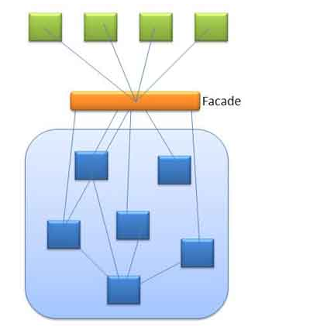
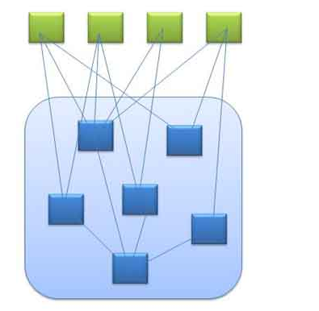

Slide 131
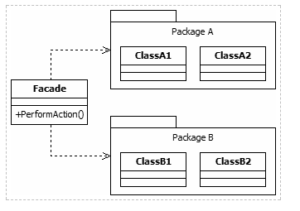

Slide 132
Example of façade pattern
Lets take a example of MediaPlayer, To start MediaPlayer we click on start button. But internally first file loading from device CD/DVD, then file will be decoded and the sound start. If you want to switch off the MediaPalyer the sound will be silent and file will be unloading.

Slide 133
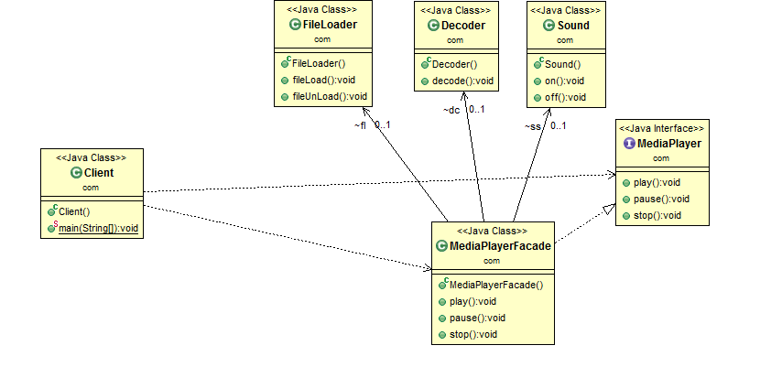

Slide 134
Uses of Façade Pattern
It shields the clients from the complexities of the sub-system components.
It promotes loose coupling between subsystems and its clients.
When you want to provide simple interface to a complex sub-system.
When several dependencies exist between clients and the implementation classes of an abstraction.
Putting all methods in a facade is not a good approach. You should think about splitting into several facades and group the methods based on their functionality.

Slide 135
Flyweight
Definition
Uses sharing to support large numbers of fine-grained objects efficiently
Problem & Context
This pattern suggests separating all the intrinsic common data into a separate object referred to as a Flyweight object. The group of objects being created can share the Flyweight object as it represents their intrinsic state. This eliminates the need for storing the same invariant, intrinsic information in every object; instead it is stored only once in the form of a single Flyweight object
Solution
Design flyweight as a singleton with a private constructor. The client creates an object with the exclusive extrinsic data or sends the extrinsic data as part of a method call to the Flyweight object. This results in the creation of few objects with no duplication
Notes:
Frequency of use: Medium low (2 of 5)
Sample application:
The characters stored in a word processor represent objects that have font face, font size, and other formatting data. Each of the character objects would contain a reference to a separate formatting object which contains the required properties.
An online job site that receives data files from different employers with current openings in their organizations. Many of the data are the same for all jobs for a given employer.

Slide 136
Flyweight state
Intrinsic states are things that are constant and are stored in the memory.
Example Shape width and height and position.
Extrinsic states are things that are not constant and need to be calculated on the fly, and are therefore not stored in the memory.
Shape color, thickness

Slide 137
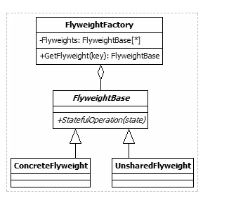

Slide 138
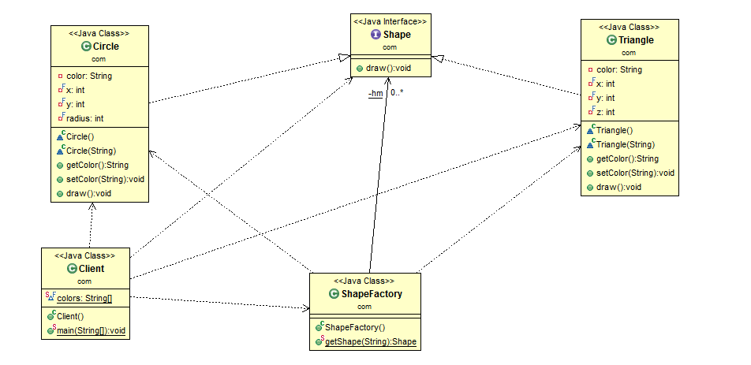

Slide 139
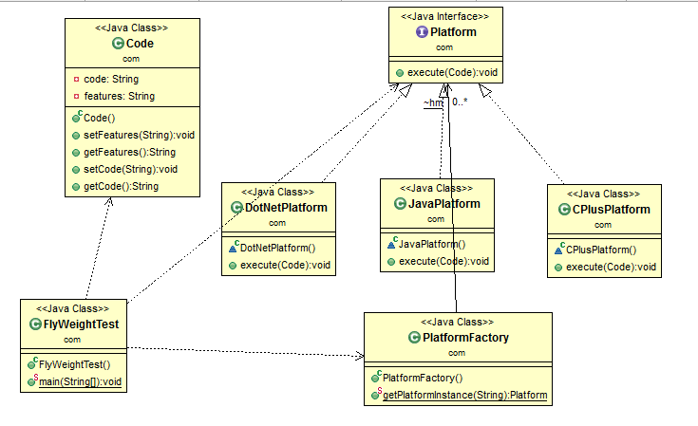

Slide 140
Use of flyweight pattern
An application uses a large number of objects.
Storage costs are high because of the sheer quantity of objects.
Most object state can be made extrinsic.
Many groups of objects may be replaced by relatively few shared objects once extrinsic state is removed.
The application doesn’t depend on object identity. Since flyweight objects may be shared, identity tests will return true for conceptually distinct objects.

Slide 141
Proxy
Definition
Provides a surrogate or placeholder for another object to control access to it
Problem & Context
A client object can directly access a service provider object but sometimes a client object may not have access to a target object by normal means. The reasons could be: location, state of existence, and special behavior of target object. Instead of having client objects to deal with the special requirements for accessing the target object, the Proxy pattern suggests using a separate object referred to as a proxy to provide a means for different client objects to access the target object in a normal, straightforward manner
Solution
A proxy object should represent a single object. It provides access control to the single target object, and offers the same interface
Notes:
There are several types of proxies used in different scenarios: Remote Proxy, Virtual Proxy, Cache/Server Proxy, Firewall Proxy, Protection Proxy, Synchronization Proxy, Smart Reference Proxy, Counting Proxy
Frequency of use: High (5 of 5)
Sample application:
Any application that uses RMI where a stub class acts as a remote proxy for the remote object.

Slide 142
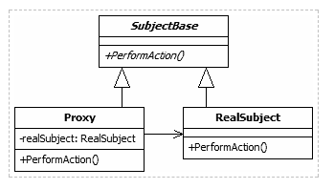

Slide 143
Types of proxies
Cache Proxy. A cache proxy improves the performance of the underlying object's members when they perform long-running tasks that return seldom-changing results.
Protection Proxy. A protection proxy adds a layer of security to the underlying subject object.
Remote Proxy. A remote proxy provides a local object that references a subject object in another location, generally via a network connection.
Smart Proxy. Smart proxies add extra functionality to the calls to the real object's members. This functionality is often invisible to the client object.

Slide 144
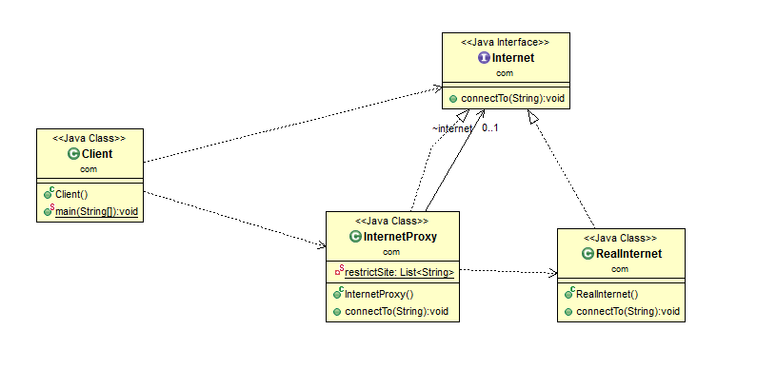

Slide 145
Pts
A proxy may hide information about the real object to the client.
A proxy may perform optimization like on demand loading.
A proxy may do additional house-keeping job like audit tasks.
Proxy design pattern is also known as surrogate design pattern.
java.rmi.* – RMI package is based on proxy design pattern –(Stub and Skeleton)

Slide 146
Pros and cons of proxy pattern
Pros
We don't need to update the existing top level class with any flag to check if this feature is enabled, and to conditionally execute code.
Single point of control
Cons
There are ways of more tightly binding between proxy and legacy.
Unnecessarily complicated

Slide 147
Behavioural Patterns

Slide 148
Chain of Responsibility
Definition
Avoids coupling the sender of a request to its receiver by giving more than one object a chance to handle the request. Chain the receiving objects and pass the request along the chain until an object handles it
Problem & Context
When there is more than one object that can handle or fulfill a client request, each of these potential handler objects can be arranged in the form of a chain, with each object having a pointer to the next object in the chain
Solution
The order in which the objects form the chain can be decided dynamically at runtime by the client. All potential handler objects should provide a consistent interface. Neither the client object nor any of the handler objects in the chain need to know which object will actually fulfill the request
Notes:
Frequency of use: Medium (3 of 5)
Sample application:
Several levels of managers and executives can respond to a purchase request or hand it off to a superior. Each position has can have its own set of rules about which orders they can approve.

Slide 149
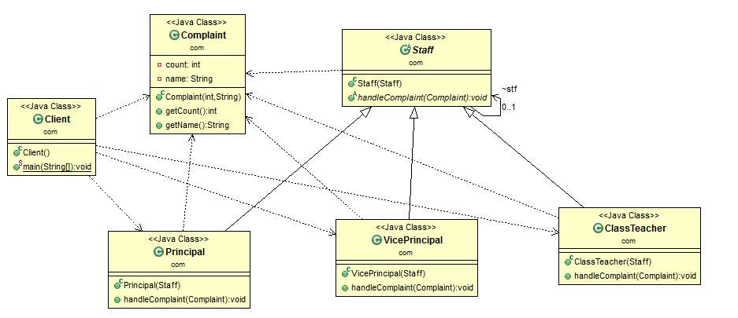

Slide 150
Command
Definition
Encapsulates a request as an object, thereby letting you parameterize clients with different requests, queue or log requests, and support undoable operations
Problem & Context
Used when there is a proliferation of similar methods and the interface to implement an object becomes unwieldy – too many public methods for other objects to call, an interface that is unworkable and always changing
Solution
Create an abstraction for the processing in response to client requests by declaring a common interface to be implemented by different concrete implementers referred to as Command objects. A given Command object does not contain the actual implementation of the functionality. Command objects make use of Receiver objects in offering this functionality
Notes:
Frequency of use: Medium high (4 of 5)
Sample application:
In GUIs, a menu item object can be connected with different Commands where a menu item object does not need to know any details of what action the Command performs.
In a simple calculator with unlimited number of undo's and redo's.

Slide 151
Use of a command pattern
In real time project
Insert the record in db, call a service layer to update a related record. Updated on the view layer. Call another service to log a ticket.
To perform this in a transactional manner, each operation is implemented as a command with undo operation. At the end of each step, the command is pushed onto a stack. If the operation fails at some step, then we pop the commands from the stack and call undo operation on each of the command popped out. The undo operation of each step is defined in that command implementation to reverse the earlier command.execute().

Slide 152
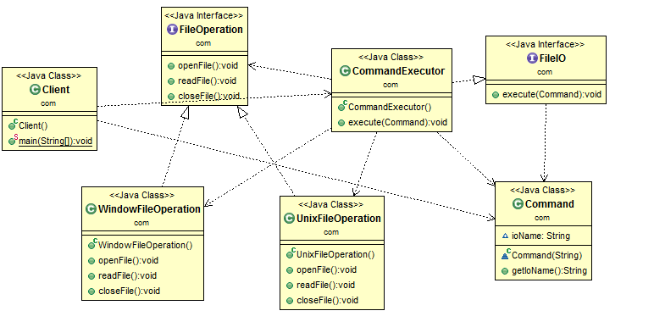

Slide 153
Pros and cons of command pattern
Pros
Decouples the object that invokes the operation from the one that know how to perform it
This pattern helps in terms of extensible as we can add a new command without changing the existing code.
It allows you to create a sequence of commands named macro. To run the macro, create a list of Command instances and call the execute method of all commands.
Cons
increase in the number of classes for each individual command

Slide 154
Interpreter
Definition
Given a language, defines a representation for its grammar along with an interpreter that uses the representation to interpret sentences in the language
Problem & Context
Sometimes an application may process repeated similar requests that are a combination of a set of grammar rules. These requests are distinct but similar in the sense that they are composed using the same set of rules. Instead of treating every distinct combination of rules as a separate case, it may be beneficial for the application to have the ability to interpret a generic combination of rules
Solution
Design a class hierarchy to represent the set of grammar rules with every class in the hierarchy representing a separate grammar rule. An Interpreter module interprets the sentences constructed using the class hierarchy and carries out the necessary operations
Notes:
Frequency of use: Low (1 of 5)
Sample application:
Convert a Roman numeral to a decimal
An interpreter for the DOS copy command

Slide 155
Iterator
Definition
Provides a way to access the elements of an aggregate object sequentially without exposing its underlying representation
Problem & Context
The purpose of an iterator is to process every element of a container while isolating the user from the internal structure of the container. The container allows the user to treat it as if it were a simple sequence or list while storing elements in any manner it wishes. Iterators can provide a consistent way to iterate on data structures of all kinds, making the code more readable, reusable, and less sensitive to a change in the data structure
Solution
In Java, the java.util.Iterator interface allows you to iterate container classes. Each Iterator provides a next() and hasNext() method, and may optionally support a remove() method. Iterators are created by the method iterator() provided by the corresponding container class
Notes:
Frequency of use: High (5 of 5)
Sample application:
1. Display data from a Candidates file containing details of different IT professionals who have offered their candidacy for a job opening.

Slide 156
Use of Iterator pattern
It supports variations in the traversal of a collection.
It simplifies the interface to the collection.
When you want to access a collection of objects without exposing its internal representation.

Slide 157
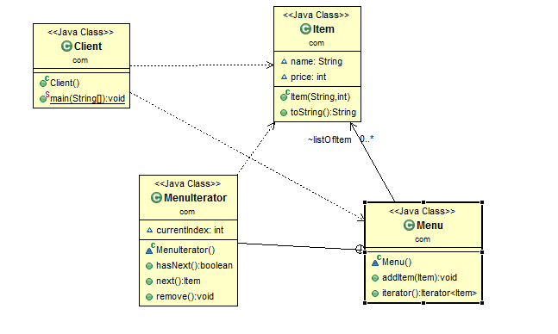

Slide 158
Mediator
Definition
Defines an object that encapsulates how a set of objects interact. Mediator promotes loose coupling by keeping objects from referring to each other explicitly, and it lets you vary their interaction independently
Problem & Context
Objects interact with each other for the purpose of providing a service. This interaction can be direct (point-to-point). As the number of objects increases, the interaction can lead to a complex maze of references among objects. Having an object directly referring to other objects greatly reduces the scope for reuse
Solution
The Mediator pattern suggests abstracting all object interaction details into a separate class, referred to as a Mediator. The interaction between any two different objects is routed through the Mediator class. All objects send their messages to the mediator
Notes:
Frequency of use: Medium low (2 of 5)
Sample application:
The communication between different Participants registering with a Chatroom. The Chatroom is the central hub through which all communication takes place. At this point, only one-to-one communication is implemented in the Chatroom, but it could be easily chanted to one-to-many.

Slide 159
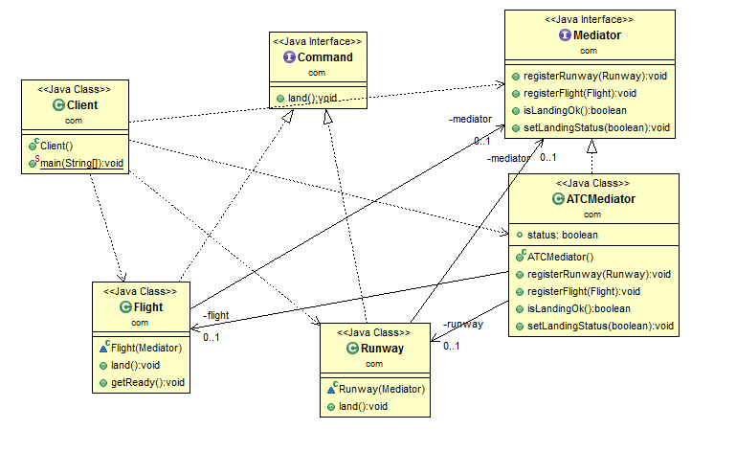

Slide 160
Memento
Definition
Without violating encapsulation, captures and externalizes an object's internal state so that the object can be restored to this state later
Problem & Context
The state of an object can be defined as the values of its attributes at any given point of time. The Memento pattern is useful for designing a mechanism to capture and store the state of an object so that, when needed, the object can revert to its previous state. This is more like an undo operation
Solution
The object whose state needs to be captured is referred to as the originator. The originator stores its attributes in a separate object referred to as a Memento. A Memento object must hide the originator variable values from all objects except the originator. A Memento should be designed to provide restricted access to other objects while the originator is allowed to access its internal state
Notes:
Frequency of use: Low (1 of 5)
Sample application:
Consider a customized wedding gown. Users can select different neck and sleeve types and a preview image will be updated. Users can undo a selection and the preview should get updated accordingly.
Consider a shopping cart application that remembers shopping cart contents even after a user has logged out. The next time the user logs on to the web site, the shopping cart should show previously selected items.

Slide 161
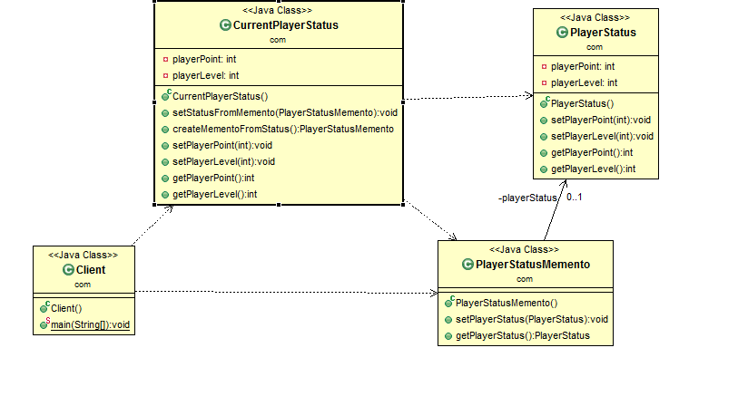

Slide 162
Applicability
Use the Memento pattern when:
1> a snapshot of (some portion of ) an object’s state must be saved so that it can be restored to that state later
2> a direct interface to obtaining the state would expose implementation details and break the object’s encapsulation.

Slide 163
Observer
Definition
Defines a one-to-many dependency between objects so that when one object changes state, all its dependents are notified and updated automatically
Problem & Context
Useful for designing a consistent communication model between a set of dependent objects (observers) and an object that they are dependent on (subject). This allows the observers to have their state synchronized with the subject. Each of these observers needs to know when the subject undergoes a change in its state
Solution
The subject should provide an interface for registering and unregistering change notifications. Observers should provide an interface for receiving notifications from the subject
Notes:
Frequency of use: High (5 of 5)
Sample application:
Event-driven programming especially in GUI toolkits.
A job-alert program that sends email notification to subscribers after setting their work preferences.

Slide 164
Use of Observer Design pattern
The observer pattern defines a one to many dependency between objects so that when one object changes state, all of its dependent or related objects get notified automatically.
Group Chat is a real life example of observer pattern. Whenever someone type some text in text button and hit send button. Every member get notified that someone texted in group.

Slide 165
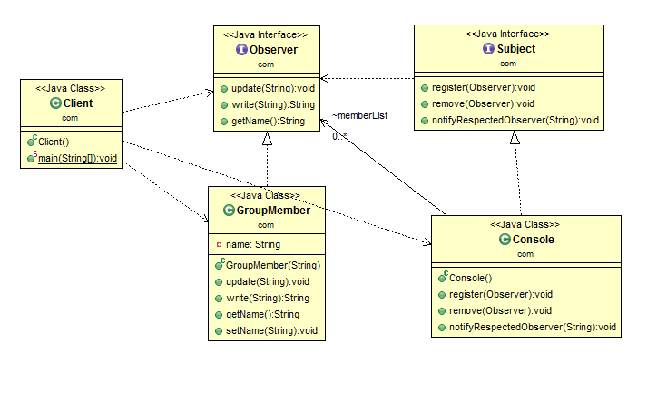

Slide 166
Use the Observer pattern in any of the following situations:
When an abstraction has two aspects, one dependent on the other. Encapsulating these aspects in separate objects lets you vary and reuse them independently.
When a change to one object requires changing others, and you don’t know how many objects need to be changed.
When an object should be able to notify other objects without making assumptions about who these objects are. In other words, you don’t want these objects tightly coupled.

Slide 167
Pros and cons of Observer pattern
Pros
Supports the principle to strive for loosely coupled designs between objects that interact.
Allows you to send data to many other objects in a very efficient manner.
No modification is need to be done to the subject to add new observers.
Cons
Favours inheritance over composition.
If not used carefully the observer pattern can add unnecessary complexity

Slide 168
State
Definition
Allows an object to alter its behavior when its internal state changes. The object will appear to change its class
Problem & Context
Useful in designing an efficient structure for a class, a typical instance of which can exist in many different states and exhibit different behavior depending on its state. In the case of an object of such a class, some or all of its behavior is completely influenced by its current state. Such a class is referred to as a Context class. A Context object can alter its behavior when there is a change in its internal state and is also referred as a Stateful object
Solution
The State pattern suggests moving the state-specific behavior out of the Context class into a set of separate classes referred to as State classes. Each of the many different states in which a Context object can exist can be mapped into a separate State class
Notes:
Frequency of use: Medium high (4 of 5)
Sample application:
Consider an Account that behaves differently depending on its balance. The difference in behavior is delegated to State objects called RedState, SilverState and GoldState. These states represent overdrawn accounts, starter accounts, and accounts in good standing.
Most HTML editors offer several views of HTML page (e.g., Design view, HTML view, Quick Page view). When a user selects one of these views (change in the state of the Editor object), the behavior of the Editor object changes in terms of the way the current Web page is displayed.

Slide 169
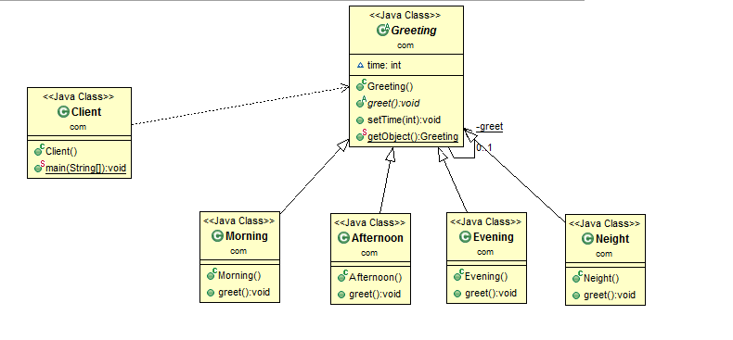

Slide 170
Strategy
Definition
Defines a family of algorithms, encapsulates each one, and makes them interchangeable. Strategy lets the algorithm vary independently from clients that use it
Problem & Context
Useful when there is a set of related algorithms and a client object needs to be able to dynamically pick and choose an algorithm that suits its current need. The implementation of each of the algorithms is kept in a separate class referred to as a strategy. An object that uses a Strategy object is referred to as a context object. Changing the behavior of a Context object is a matter of changing its Strategy object to the one that implements the required algorithm
Solution
All Strategy objects must be designed to offer the same interface. In Java, this can be accomplished by designing each Strategy object either as an implementer of a common interface or as a subclass of a common abstract class that declares the required common interface
Notes:
Frequency of use: Medium high (4 of 5)
Sample application:
An application that searches for an item from a list which decides the search algorithm (e.g., binary search or linear search) to be used.
An application that calculates simple and the compound interest.

Slide 171
Real world example of this pattern
The strategy pattern has found its place in JDK, and you know what I mean if you have sorted ArrayList in Java. Yes, combination of Comparator, Comparable, and Collections.sort() method are one of the best real world example of Strategy design pattern
The strategy pattern defines a family of related algorithms e.g. sorting algorithms like bubble sort, quicksort, insertion sort and merge sort, or compression algorithm e.g. zip, gzip, tar, jar, encryption algorithm e.g. MD 5, AES etc and lets the algorithm vary independently from clients that use it.

Slide 172
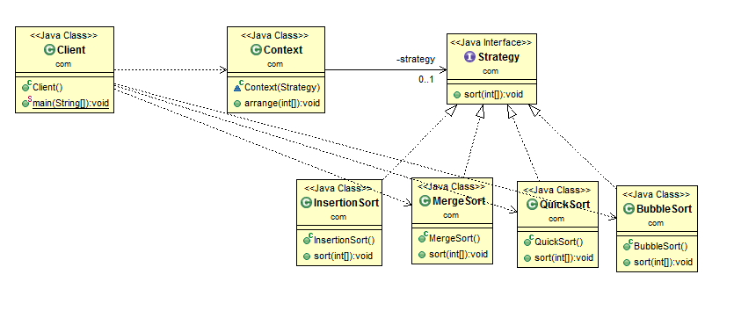

Slide 173
Pros and Cons Strategy Pattern
The client can choose any algorithm at run time, you can easily add new Strategy without modifying classes which use strategies e.g. Context. This becomes possible because Strategy pattern is based upon Open Closed design principle, which says that new behavior is added by writing new code not by modifying tried and tested old code.
If you use Strategy pattern, you will be adding a new Strategy by writing a new class which just need to implement Strategy interface. Because of open closed principle violation, we cannot use Enum to implement Strategy pattern.

Slide 174
Template Method
Definition
Defines the skeleton of an algorithm in an operation, deferring some steps to subclasses. Template Method lets subclasses redefine certain steps of an algorithm without changing the algorithm's structure
Problem & Context
Used in situations when there is an algorithm, some steps of which could be implemented in many different ways. The outline of the algorithm is kept in a separate method referred to as a template method inside a class, referred to as a template class, leaving out the specific implementations of the variant portions of the algorithm to different subclasses of this class
Solution
The Template method can be a concrete, non abstract method with calls to other methods that represent different steps of the algorithm. Specific implementations can be provided for these abstract methods inside a set of concrete subclasses of the abstract Template class
Notes:
The Template Method pattern is one of the simplest and most frequently used design patterns in object-oriented applications.
The Template pattern implementation relies heavily on inheritance and function overriding. Whenever inheritance is used for implementing the specifics, it can be said that Template Method pattern is used in its simplest form.
Frequency of use: High (5 of 5)
Sample application:
1. An applet with custom code in any of the applet life-cycle methods (init, start, paint, stop and destroy).

Slide 175
When to use this pattern
When you have a preset format or steps for algorithm but implementation of steps may vary.
When you want to avoid code duplication, implementing common code in base class and variation in subclass.

Slide 176
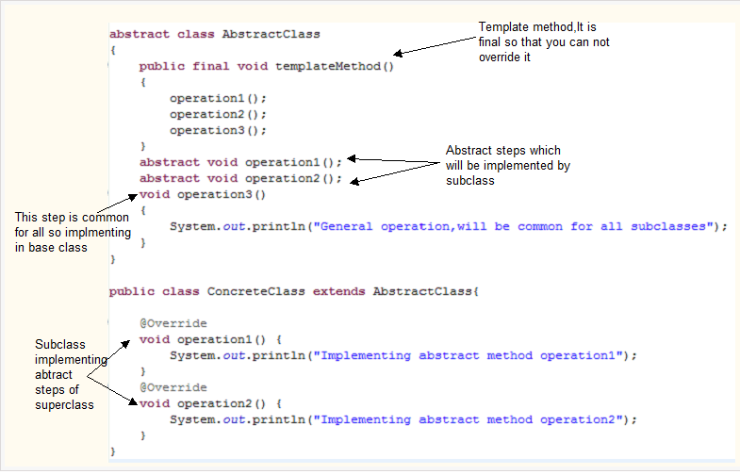

Slide 177


Slide 178
Pts
Template method in super class follows “the Hollywood principle”: “Don't call us, we'll call you”. This refers to the fact that instead of calling the methods from base class in the subclasses, the methods from subclass are called in the template method from super class.
Template method in super class should not be overridden so make it final
Template methods are technique for code reuse because with this , you can figure out common behavior and defer specific behavior to subclasses.

Slide 179
Pros and cons of Template pattern
Pros
It reduces code duplication.
Cons
There is a ridiculous amount of boiler-plate code involved.
Restricts you to a single inheritance in Java.

Slide 180
Visitor
Definition
Represents an operation to be performed on the elements of an object structure. Visitor lets you define a new operation without changing the classes of the elements on which it operates
Problem & Context
Visitor is useful in a heterogeneous collection of objects of a class hierarchy. It allows operations to be defined without changing the class of any of the objects in the collection. The Visitor pattern suggests defining the operation in a separate class referred to as a visitor class, which separates the operation from the object collection on which it operates. For every new operation to be defined, a new visitor class is created
Solution
Every visitor class that operates on objects of the same set of classes can be designed to implement a corresponding Visitor interface. A typical Visitor interface declares a set of visit(ObjectType) methods, one for each object type from the object collection. Each of these methods is meant for processing instances of a specific class
Notes:
Frequency of use: Medium low (2 of 5)
Sample application:
Two objects traverse a list of Employees and performs the same operation on each Employee. The two visitor objects define different operations -- one adjusts vacation days and the other income.

Slide 181


Slide 182
Key Points
Design Patterns are recurring solutions to software design problems within a particular context
There are 23 Design Patterns described by the GoF
Design Patterns are categorized into Creational, Structural, and Behavioral
There are other Design Patterns in existence
Notes:
Design Patterns are sometimes vague and difficult to comprehend, but over time you will learn how to identify and apply them in your project.

Slide 183
References
Design Patterns: Elements of Reusable Object-Oriented Software
By: Erich Gamma, et al.
Software Architecture Design Patterns in Java
By: Partha Kutchana
The Design Patterns Java Companion
By: James W. Cooper
http://www.dofactory.com/Patterns/Patterns.aspx
http://www.cmcrossroads.com/bradapp/docs/patterns-intro.html
http://en.wikipedia.org/wiki/Design_pattern_(computer_science)

Slide 184
Core JEE Design Pattern

Slide 185
Layered pattern
Layering is a common architectural pattern employed to help break up complicated software.
Each layer is responsible for exposing a principal service, and layers are typically divided based on their primary functional responsibilities.
Packages are an excellent way to represent the logical layers composing an application.
Higher-level layers (or a package representing a layer) sit a top lower-level layers, using their services.
Lower-level layers, however, know nothing of the higher-level layers that use them.

Slide 186
Presentation Layer | Responsible for display of application user interface components and handling user requests
Domain | Responsible for the application specific business logic
Data source | Facilitates communications with underlying services such as database connectivity, messaging systems, transaction management, etc.

Slide 187
Pts
Defining meaningful application layers is important because well-defined layers promote maintainability and reusability.
Defining more application layers results in each layer needing to present more fine-grained services.
This can be a challenging task when determining a layer’s responsibilities.

Slide 188
Partitioning
Partitioning an application focuses on separating logic not central to the business from the logic that is central to the business.
Similar to layering, partitions are typically represented logically using packages.
Types of partitioning
Vertical
Horizontal

Slide 189
Vertical | Functionality that is central to the business the application is being written to support. This includes business processes, business logic, and business rules. This may also be referred to as the domain dependent partition.
Horizontal | Functionality that is not central to the business the application is being written to support. This includes services such as error handling, mailing services, and database access. Horizontal services may have an application façade that attaches application-specific functionality to the horizontal service. This may also be referred to as the domain independent partition.

Slide 190

JSP Model 1 Architecture

Slide 191
Pros and Cons JSP Model 1
Pros
Easy and Quick to develop web application
Cons
It is hard to achieve of labour between pages designer and web developer because normally the web developer needs to involved in the development of the pages and business object.
It is hard to maintain and it is not flexible. This is specially true for large project.

Slide 192
Partitioning
Partitioning an application focuses on separating logic not central to the business from the logic that is central to the business.
Similar to layering, partitions are typically represented logically using packages.
Types of partitioning
Vertical
Horizontal

Slide 193
Vertical | Functionality that is central to the business the application is being written to support. This includes business processes, business logic, and business rules. This may also be referred to as the domain dependent partition.
Horizontal | Functionality that is not central to the business the application is being written to support. This includes services such as error handling, mailing services, and database access. Horizontal services may have an application façade that attaches application-specific functionality to the horizontal service. This may also be referred to as the domain independent partition.

Slide 194
JSP Model 1 Architecture

Slide 195
Pros and Cons JSP Model 1
Pros
Easy and Quick to develop web application
Cons
It is hard to achieve of labour between pages designer and web developer because normally the web developer needs to involved in the development of the pages and business object.
It is hard to maintain and it is not flexible. This is specially true for large project.

Slide 196

JSP Model 2 (MVC) Design Pattern

Slide 197
MVC (Model View Controller)
Model : Normal Java classes
The model represents the state (data) and business logic of the application.
View : HTML / JSP / JavaScript library
The view module is responsible to display data i.e. it represents the presentation.
Controller : Servlet or type of Servlet
The controller module acts as an interface between view and model. It intercepts all the requests i.e. receives input and commands to Model / View to change accordingly.

Slide 198
Pros and Cons of MVC
Pros
Navigation control is centralized Now only controller contains the logic to determine the next page.
Easy to maintain
Easy to extend
Easy to test
Better separation of concerns
Cons
Need of multiple programmers.
Knowledge on multiple technologies are required

Slide 199
Core JEE Design Pattern
Core JEE patterns are broadly classified in the following three categories based on the layering of the multi tiered systems. A specific patterns applies to a specific layer of the system under development
Presentation Tier Patterns
Business Tier Pattern
Integration Tier Pattern

Slide 200
Presentation Tier Pattern
Interception Filter
Front Controller
Application Controller
Context Object
View Helper
Composite View
Service to Worker
Dispatcher View

Slide 201
Business Tier Pattern
Business Delegates
Service Locator
Session Facade
Application Service
Business Object

Slide 202
Integration Tier Pattern
Date Access Object
Service Activator
Domain Store
Web Service Broker

Slide 203
Presentation Tier Pattern

Slide 204
Interceptor Filter
Intercepting Filter intercepts incoming requests and outgoing responses and applies a filter.
These filters may be added and removed in a declarative manner.
After this pre processing and/or post-processing is complete, the final filter in the group vectors control to the original target object.

Slide 205
Pts
The presentation-tier request handling mechanism receives many different types of requests, which require varied types of processing. Some requests are simply forwarded to the appropriate handler component, while other requests must be modified, audited, or uncompressed before being further processed.
One of the best example for Intercepting Filter Pattern is Spring Security's DelegatingFilterProxy , which will intercept the HTTP request and do the authentication check. Spring security build on chain of filters.

Slide 206
Continue...
Has the client been authenticated?
Does the client have a valid session?
Is the client's IP address from a trusted network?
Does the request path violate any constraints?
What encoding does the client use to send the data?

Slide 207


Slide 208


Slide 209
Interceptor Filter API
Filter : The filter is responsible for performing a particular task before or after the execution of the request by its request handler.
Target : The target is, in fact, the target object- a request handler.
Filter Chain : Filter chain carries a chain of filters which are to be implemented on the target, in different and defined order.
Filter Manager : Filter manager is responsible for managing the filters and filter chain.
Client : The client is the object which sends the requests to the Target object.

Slide 210
Benefits
Centralizes pre-processing of requests
Centralizes post-processing of responses
When to use
You need to pre-process a request or response.
You need to post-process a request or response.

Slide 211
Real time example
javax.servlet.Filter(interface)
A filter is an object that performs filtering tasks on either the request to a resource (a servlet or static content), or on the response from a resource, or both. Filters perform filtering in the doFilter method.
Every Filter has access to a FilterConfig object from which it can obtain its initialization parameters, a reference to the ServletContext which it can use, for example, to load resources needed for filtering tasks.

Slide 212
Front Controller
Front Controller is a container to hold the common processing logic that occurs within the presentation tier and that may otherwise be erroneously placed in a View.
A controller handles requests and manages content retrieval, security, view management, and navigation, delegating to a Dispatcher component to dispatch to a View.
The Front Controller is different from the Intercepting Filter in that the Front Controller is determining processing based on the request and an Intercepting Filter is modifying the request.

Slide 213


Slide 214
Benefits
Centralizes control logic
Improves reusability
Improves separation of concerns
When to use
Apply common logic to multiple requests
Separate processing logic from view

Slide 215
Pts
You want to avoid duplicate control logic.
You want to apply common logic to multiple requests.
You want to separate system processing logic from the view.
You want to centralize controlled access points into your system.

Slide 216
Real time example
The best example of this pattern is Spring MVC DispatcherServlet is a front controller who handles all the user request and processes the request as per there mapping.

Slide 217
Application Controller
Application Controller centralizes control, retrieval, and invocation of view and command processing.
While a Front Controller acts as a centralized access point and controller for incoming requests, the Application Controller is responsible for identifying and invoking commands, and for identifying and dispatching to views.
The Application Controller pattern is used to centralize retrieval and invocation of request-processing components, such as commands and views.

Slide 218


Slide 219
Benefits
Improves extensibility
Improves separation of concerns
When to use
Apply common control logic
Have centralized view management

Slide 220
InteceptionFilter Vs Front Controller Vs ApplicationController
Intercepting Filter -> pluggable behavior: security, i18n...
Front Controller -> request format matters: taking the request parameters to build a command or something similar.
Application Controller – Controls the page flow. Means which actually dispatches the request to the appropriate action/page.

Slide 221
Context object
Context Object encapsulates state in a protocol-independent way to be shared throughout your application.
Using Context Object makes testing easier, facilitating a more generic test environment with reduced dependence upon a specific container.
The Context Object pattern is used to encapsulate the specifics of protocol implementation to be shared.

Slide 222


Slide 223


Slide 224
Benefits
Improves reusability and maintainability
Allows code to be portable across operating systems
When to use
Components need access to system information
Decouple application from underlining protocols and system interfaces

Slide 225
View Helper
View Helper encourages the separation of formatting-related code from other business logic.
The View component is then left to encapsulate the presentation formatting.
Helper components typically delegate to the business services via a Business Delegate or an Application Service.
The View Helper pattern separates the processing logic from the view.

Slide 226


Slide 227
Benefits
Separates logic from the view
When to use
Encapsulate view-processing logic

Slide 228
Composite View
Composite View suggests composing a View from numerous atomic pieces.
Multiple smaller views, both static and dynamic, are pieced together to create a single template.
The Composite View pattern combines simple views into a more complex view without handling the content or layout.

Slide 229


Slide 230
Participants
View
A common interface implemented by both composite and leaf views.
Leaf view
A view responsible for data that is actually displayed.
Composite view
A view responsible for managing other views, including both leaves and other composites

Slide 231

Real time API
Apache Tiles and SiteMesh frameworks uses Composite View Design Pattern.

Slide 232
Benefits
Code duplication is reduced because you can create common headers, footers, and other components.
Views can be changed based on access authorization.
When to use
You want common view components.
You view component changes based on authorization.

Slide 233
Business Tier Pattern

Slide 234
Business Delegation
Business Delegate reduces coupling between remote tiers and provides an entry point for accessing remote services in the business tier.
A Business Delegate might also cache data as necessary to improve performance.
The Business Delegate pattern hides the complexity of remote communication with business components from the client.

Slide 235
Pts
The Business Delegate pattern adds an abstraction layer between presentation and business tiers. By using the pattern we gain loose coupling between the tiers and encapsulate knowledge about how to locate, connect to, and interact with the business objects that make up the application.
Business Delegate Pattern is used to decouple presentation tier and business tier.

Slide 236


Slide 237
Benefits
Minimizes coupling of clients to business services
Hides remoteness
Improves performance
When to use
Want to encapsulate access to business services from multiple client types
Translate exceptions into application exceptions
Hide details of service creation

Slide 238
Service Locator
The service locator design pattern is used when we want to locate various services using JNDI lookup.
Considering high cost of looking up JNDI for a service, Service Locator pattern makes use of caching technique.
Service Locator looks up in JNDI and caches the service object. Further lookup or same service via Service Locator is done in its cache which improves the performance of application to great extent .

Slide 239


Slide 240
Benefits
Standardized approach to retrieving business components
When to use
You have many different business services that are located in different ways.

Slide 241
Pts
The Service Locator Pattern is to transparently locate business components and services in a uniform manner.
Spring Framework internally uses Service Locator pattern to manage Dependency Injection. These days, Service.

Slide 242


Slide 243
When to use
when network hits are expensive and time-consuming
lookups of services are done quite frequently
a large number of services are being used
Abstracts complexity
Provides uniform service access to clients
Facilitates adding EJB business components
Improves network performance
Improves client performance by caching

Slide 244
Integration Tier Pattern

Slide 245
Data Access Object
Data Access Object enables loose coupling between the business and resource tiers.
Data Access Object encapsulates all the data access logic to create, retrieve, delete, and update data from a persistent store.
Data Access Object uses Transfer Object to send and receive data.
The Data Access Object pattern encapsulates access to a persistent store by managing the connection with the data store.

Slide 246


Slide 247
Benefits
Reduces code complexity in client
Improves code reuse
Provides easier migration to new data store
When to use
Decouple data access from the business logic
Provide all data access from in a separate layer

Slide 248
Service Activator
Service Activator enables asynchronous processing in your enterprise applications using JMS.
A Service Activator can invoke Application Service, Session Façade or Business Objects.
You can also use several Service Activators to provide parallel asynchronous processing for long running tasks.
The Service Activator pattern handles asynchronous requests to business components.

Slide 249


Slide 250
Domain Store
Domain Store provides a powerful mechanism to implement transparent persistence for your object model.
The Domain Store pattern separates the persistence of an object from the object model.
Unlike J2EE's container-managed persistence and bean-managed persistence, which include persistence support code in the object model, Domain Store's persistence mechanism is separate from the object model.

Slide 251
Benefits
Decouples business logic from persistence logic
When to use
You do not want to use entity beans.
Object model uses are complex.

Slide 252
Web Service Broker
Web Service Broker exposes and brokers one or more services in your application to external clients as a web service using XML and standard web protocols.
A Web Service Broker can interact with Application Service and Session Façade.
A Web Service Broker uses one or more Service Activators to perform asynchronous processing of a request.
The Web Service Broker pattern exposes and brokers services using XML and web protocols.

Slide 253
Benefits
Exposes existing services to web
When to use
Need to expose services as web services

Slide 254
Thank You!

